Slide 1
Acorn Project
When we come up wih an idea
Aaron Fox, Bryer Johnson, Mickey Nelson

Slide 2
Project Progress
Project 1: COMPLETE
Project 2: COMPLETE
Project 3: COMPLETE
Project 4: COMPLETE

Slide 3
Project 1: Pandemic/Reverse Charades
Influence: Group
BYU-I ILO: Skilled collaborators
Values: Become better at collaborating with one another, improve teamwork and professionalism, and improve the overall influence we have as a team.
Vision: Provide unique opportunities to work together as a team despite adversity, growing and improving along the way
SMART Goal: meet 3 times within the next 3 weeks to learn how to master the games of Pandemic and Reverse charades. In between sessions, meetup to discuss strategy

Slide 4
Project 1: The journey
COMPLETED: Work together to attempt winning pandemic at least once with our best effort and reverse charades five times in a row.
COMPLETED: Begin each game with a carefully planned strategy.
COMPLETED: Met another time to improve upon our strategies and apply them to beat the games.

Slide 5
What we learned:
Pandemic is harder than it looks
Even with “Bro Clemen” coming in with the clutch, we still lost miserably
Reverse charades is harder than it looks
Seemingly simple words quickly become impossible (e.g. salad)
BUT we can overcome hard things as a team
E.g. Buzz-Lightyear
Teamwork skills come with practice
Collaboration completely relies on trust and humility

Slide 6
Project 2: CIT Society Meetings
Influence: Group/self
ILO Mission: Effective Communicators
Values: Accomplishing a large task through effective teamwork
Vision: Create a miniature smart house with working lights and automatic temperature management.
Goal: Meet on Wednesdays for three weeks. Help the society construct the model house. Lights and fans should be accomplished by the end.

Slide 7
Project 2: The Journey
COMPLETED: Learn how to program smart lights. Each person has learned what programs we have used to program the lights and how to turn them on and off.
COMPLETED: Learn how to power on the smart fans. By using a laptop charger and by putting the correct wires from the fan to a board we have been able to effectively make the fans run.
COMPLETED: Learn how to solder effectively. Each person in the group has learned how to solder and decent enough to get the lights boards together.

Slide 8
Project 2: CIT Society Meetings
Learned:
We can all effectively solder now
Utilize Raspberry-Pi and various components to incorporate smart technology
Troubleshoot faulty wiring or programming
With tiny tasks, large projects are much more manageable and realistic

Slide 9
Project 3: Escape Rooms
Influence: Group
ILO Mission: Sound Thinkers
Values: Effectively think and operate together as a single unit. Be able to solve a problem while under pressure.
Vision: Be able to solve problems as a team. Escape rooms provide the opportunity to think outside the box.
Goal: Research escape rooms, online escape room and actual escape room.

Slide 10
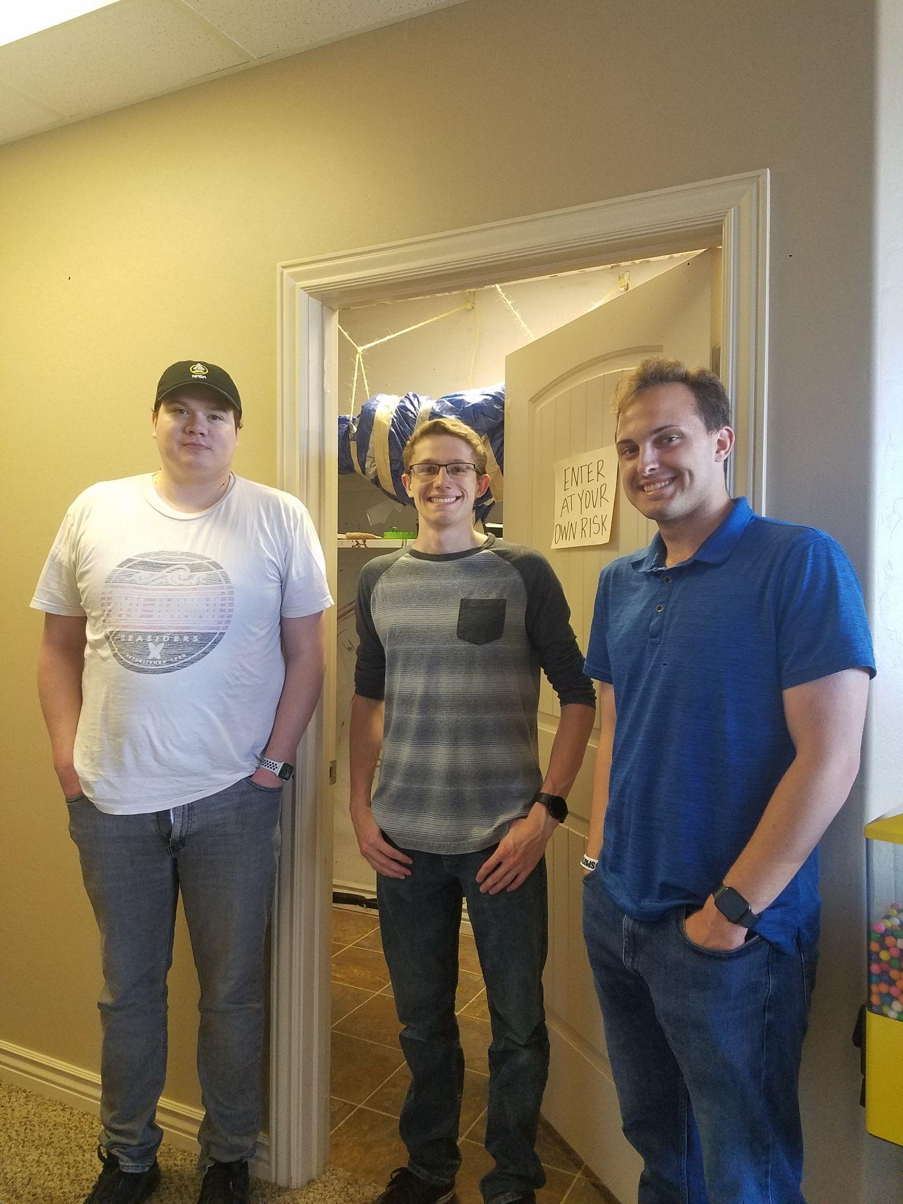
Project 3: The Journey
COMPLETED: Research common escape room practices.
COMPLETED: Perform online escape room practices.
COMPLETED: Sign up for and attempt an in-person escape room
FAILED: Save Duct-Tape Person

Slide 11
Project 3: Escape Rooms
Learned:
How to bounce ideas around
How to consider unique possibilities
Team quirks
Aaron can open toilets
Mickey can decipher mirror smudges
Bryer can read shower curtains

Slide 12
Project 4: I-belong activities
Influence: Self/Community
ILO Mission: Disciples of Jesus Christ
Values: Work to improve our personality, motivation, and connections with each other and God through I-belong activities (Bowling, ropes course, service, volunteering, etc.)
Vision: improve overall productivity, relationships with one another, and our influence on the community
SMART goal: Meet for an hour every saturday morning for four weeks and participate together in an I-belong activity

Slide 13
Project 4: The Journey
COMPLETED: Complete 2 hours of service and/or volunteering
COMPLETED: Complete the ropes course as a team, focusing on lifting each other and working together
COMPLETED: Go bowling and add our accumulative score together. Make a goal for points to reach and beat it.

Slide 14
Project 4: What we learned
Improved connections with each other
Help improve each other in a respectful, critical manner
Deeper understanding of importance of teamwork
Participating as a team helps to improve not only motivation to complete our acorn projects, but our energy to complete personal assignments and homework as well.

